Slide 1
Introduction to Programming in Python
Basic Operators & Conditional Statements
Yared Y.
yared@icraftsoft.com

Slide 2
Data Types
Python Operators
Comments
Strings and Numeric Values
Conditional Statements (if/else, for, while, …)

Slide 3
Data Types
Each value in python has a type that indicates the kind of data the value represents
Built-in data types (default to Python)
Text Type: str
Numeric Types: int, float, complex
Boolean Type: bool
You will learn others as we progress in this course (bytes, noneType, list, tuple, dict, range, set, ….)
Notes:
your programs will do more in fewer lines of code than many other languages would require

Slide 4
Data Types contd.
Int, or integer, is a whole number, positive or negative, without decimals, of unlimited length. Examples: 34, 10, 0, -280, Note – type() function is used to determine the type of data type. >>>x = 10 >>>type(x) Output: <class 'int'>
Notes:
fsafe

Slide 5
Data Types contd.
Float, or "floating point number" is a number, positive or negative, containing one or more decimals. Examples: 4.5, 0.111, 3.14, .2, .4e7, 4.2e-4 (0.00042), 1.0, 0.0
Complex numbers are written with a "j" as the imaginary part: t is specified as (real part) + (imaginary part)j. For example – 2+3j Examples: 5j, 2+3j, -5j >>>x = 1 + j >>>type(x) Output: <class ‘complex'>
Notes:
Optionally, the character e or E followed by a +ve or -ve integer may be appended to specify scientific notation
Float can also be scientific numbers with an "e" to indicate the power of 10. omplex numbers are written in the form, x + yj, where x is the real part and y is the imaginary part.

Slide 6
Boolean
Booleans represent one of two values: True or False. >>> print(10 > 9) >>> print(10 == 9) >>> print(10 < 9) >>> x = 4 > 9 >>> type(x) Output: <class 'bool'>

Slide 7
Strings
A string is a collection of one or more characters put in a single quote, double-quote or triple quote.
The string type in Python is called str. >>>s = ”Africa” >>>s output: ‘Africa’ >>>x = ”Africa is a continent.” >>>print(x) output: Africa is a continent. >>>type(x)
Notes:
A string is a collection of one or more characters put in a single quote, double-quote or triple quote. In python there is no character data type, a character is a string of length one. It is represented by str class

Slide 8
Multiline Strings
Use three quotes (double or single ) save the following code as multiline.py in code editor (write it as formatted below) print('''Craft Knowledge is an online IT training institution, born off the idea that if IT possesses the potential to change the world for the better, why not educate as many as we can in this domain at their personal convenience.'‘’)

Slide 9
Triple-quoted Strings
Use them to create: multiline strings strings containing single or double quotes Example: Including Quotes in Strings >>>print('''Display 'hi' and 'bye' in quotes'‘’) Output: Display ‘hi’ and ‘bye’ in quotes

Slide 10
Concatenating Strings
>>>first_name = ”Mohammad” >>>last_name = ”Ali” >>>full_name = first_name + “ “ + last_name >>>print(full_name) output: Mohammad Ali
Notes:
combining

Slide 11
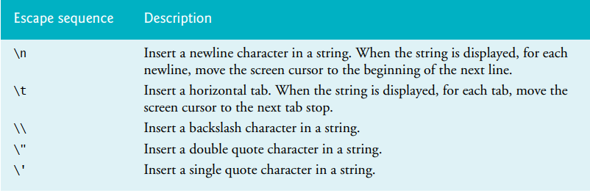
Escape Sequences
.
Notes:
A backslash character in a string indicates that one or more characters that follow it should be treated specially. (This is referred to as an escape sequence, because the backslash causes the subsequent character sequence to “escape” its usual meaning.)

Slide 12
Practice the following in the shell
>>> print('Welcome', 'to', 'Python’)
>>> print('Welcome\nto\n\nPython’)
>>> print('This is a longer string, so we \ split it over two lines’) //continuation character
>>> print("A single quote (') character")
>>> print('A double quote (") character’)
>>> print('A single quote (\') character’) //Escape character
>>> print('Do you know the backslash \\ character?’)
>>> print('Hello\tWorld’) //tab
Wait! What if you want to write \n inside a string?
>>> print(r'New Line escape character \n is very important.’)
This is called a raw string literal. It’s preceded by r or R, which specifies that escape sequences in the associated string are not translated. The backslash character is left in the string
Notes:
Ignoring a Line Break in a Long String: You may also split a long string (or a long statement) over several lines by using the \ continuation character as the last character on a line to ignore the line break. The interpreter reassembles the string’s parts into a single string with no line break. Though the backslash character in the preceding snippet is inside a string, it’s not the escape character because another character does not follow it.
The escape sequence \t causes the t character to lose its usual meaning, that of a literal t. Instead, the combination is interpreted as a tab character

Slide 13
Conversion Between Data Types
We can convert between different data types by using different type conversion functions like int(), float(), str(), etc. >>>float(45) output: 45.0 >>>complex(45) output: 45 + 0j >>>str(45) output: ‘45’
Write this in your code editor and save it as birthday.py
age = 23
message = "Happy " + age + "rd Birthday!"
print(message)
Run the code and see what happened. What goes wrong? Can you correct it? Hint: use str()

Slide 14
Implicit Vs Explicit Conversion
>>>x = 1 >>>y = 2.34 >>>z = x + y >>>type(z) // here the type of z is float like y is. In Implicit type conversion, Python automatically converts one data type to another data type.
>>>x = 1 >>>y = ’st’ >>>z = str(x) + y >>>type(z) // here the type of z is str This is called explicit conversion
Notes:
Python always converts smaller data types to larger data types to avoid the loss of data.
In Explicit Type Conversion, users convert the data type of an object to required data type. We use the predefined functions like int(), float(), str(), etc to perform explicit type conversion.
Note: You cannot convert complex numbers into another number type.

Slide 15
Comments
To explain Python code.
To make the code more readable.
Comments are very important while writing a program. They describe what is going on inside a program, so that a person looking at the source code does not have a hard time figuring it out.
Comments starts with a # (hash), and Python will ignore them #This is a comment print("Hello, World!") or print("Hello, World!") #This is a comment
""" This is a comment written in more than just one line """ print("Hello, World!")

Slide 16
Break Time
You’ve got 10 minutes for break

Slide 17
Python Operators
Arithmetic operators (Do you remember this in our last tutor ☺)
Comparison operators
>, <, ==, !=, >=, <=
Logical operators
and, or, not
Bitwise operators
&, |, ^, ~, <<, >> (and, or, xor, not, zero fill left shift, right shift)
Assignment operators
=, +=, -=, *=, /=, %=, //=, **=,
Identity operators
is, is not
Membership operators
in, not in

Slide 18
Comparison Operators
>>> x = 5 >>> y = 3 >>> print(x == y) # returns False because 5 is not equal to 3
>>> print(x <= y) # returns False because 5 is neither less than or equal to 3
>>> print(x >= y) # returns True because 5 is greater or equal to 3
>>> print(x != y) # returns True because 5 is not equal to 3
>>> print(‘x < y is ’, x < y) output: x < y is False

Slide 19
Logical Operators
Logical operators are [ and, or, not ]
and: true if both operands are true
or: true if either of the operands is true
not: complements the operands >>> True and False output: False >>> 5 > 3 or 5 == 3 + 4 output: True >>> not True output: False
>>> x = 5 >>> y = 3
>>> not x > y output: False
Check out the following >>> not 0 >>> not 4 >>> not {} >>> not “” >>> not “Hello”

Slide 20
Conditional Statements
A condition is a Boolean expression with the value True or False.
Programming often involves examining a set of conditions and deciding which action to take based on those conditions.
Python’s if statement allows you to examine the current state of a program and respond appropriately to that state.
Conditions in if statements can be formed by using the equality operators (== and !=) and relational operators (>, <, >= and <=)

Slide 21
if statement
if <expr>:
<statement>
<expr> is an expression evaluated in a Boolean context
<statement> is a valid Python statement, which must be indented >>> x = 5 >>> y = 3
>>> if x > y:
print(‘yes’)
output: yes

Slide 22
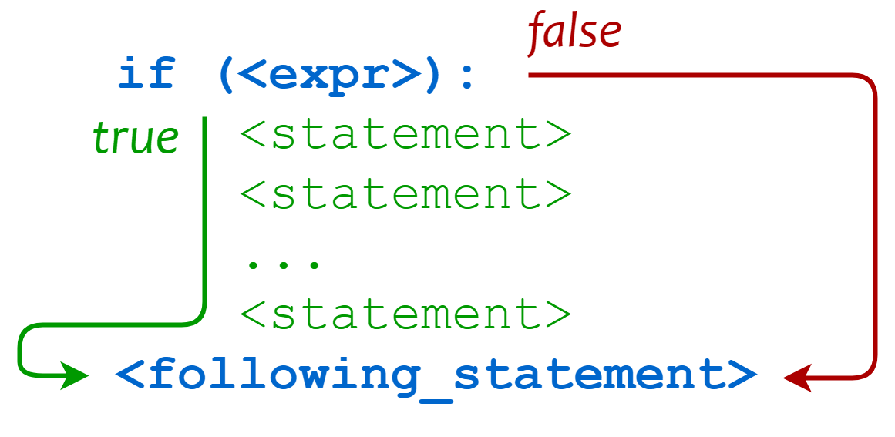
Grouping Statements
if <expr>:
<statement>
<statement>
<statement>
...
<statement>
<following_statement>

Slide 23
grade.py
grade = 60
if(grade < 50):
print("You have not got good grade")
print("Your grade is poor")
print("No, your grade is actually greater than 50")
Python: It’s All About the Indentation
Contiguous statements that are indented to the same level are considered to be part of the same block

Slide 24
More Examples
a = 33 b = 200 if b > a: print("b is greater than a")
The elif keyword is pythons way of saying "if the previous conditions were not true, then try this condition". a = 33 b = 33 if b > a: print("b is greater than a") elif a == b: print("a and b are equal")

Slide 25
else
a = 200 b = 33 if b > a: print("b is greater than a") elif a == b: print("a and b are equal") else: print("a is greater than b") The else keyword catches anything which isn't caught by the preceding conditions.

Slide 26
Getting input from the user
The input function requests and obtains user input >>> name = input(“What is your name? ”) What is your name? Nigus >>> print(name) output: Nigus
number1 = input("Enter first integer: ") number2 = input("Enter second integer: ")
if(number1 > number2):
print(number1, " is greater than", number2)
elif(number1 == number2):
print(number1, " and ", number2, " are equal")
else:
print(number1, " is less than", number2)

Slide 27
The Zen of Python
>>> import this The Zen of Python is a collection of 19 "guiding principles" for writing computer programs that influence the design of the Python programming language.
Readability Counts!

Slide 28
https://python.land/introduction-to-python
https://www.learnpython.org/en/Variables_and_Types
https://www.w3schools.com/python/default.asp

